Slide 1
Aminoglycosides
Mrs. Jagtap P.N
HOD Department of Pharmacology.
PDEA’S SGRS College of Pharmacy.

Slide 2
Introduction:-
These are a group of natural and semisynthetic antibiotics having polybasic amino groups linked glycosidically to two or more aminosugar (streptidine, 2-deoxy streptamine, garosamine) residues.
These drugs are used primarily to treat infections caused by aerobic gram-negative bacteria
Aminoglycosides are bactericidal inhibitors of protein synthesis

Slide 3
History and Source:
Natural products or semisynthetic derivatives of compounds produced by a variety of soil actinomycetes
Streptomycin was first discovered in 1944 by waksman isolated from a strain of Streptomyces griseus
Gentamicin and netilmicin are derived from species of the actinomycete Micromonospora
The term aminoglycoside stems from their structure:
Two aminosugars joined by aminocitol by glycosidic bond:
➢Aminosugar-o-deoxystreptamine -o-Aminosugar

Slide 4
In streptomycin aminocyclitol is streptidine:
Streptidine-o-Streptose aminosugar-o-n-methyl-l-glucosamine aminosugar
Spectinomycin is not aminoglycoside because aminocyclitol is not connected to any aminosugar
Properties:
All are used as sulfate salts ,which are high water soluble; solution are stable for months
They ionize in solution
-not absorb orally
-distribute only extracellularly
-don’t penetrate CSF or brain

Slide 5
Excreted unchanged in urine
Bactericidal and more active at alkaline pH
Act by interfering with protein synthesis
Active against gram-ve aerobic bacilli and do not inhibit anaerobes
There is only partial cross resistance among them
Low margin of safety
Exhibit ototoxicity and nephrotoxicity

Slide 6
Classification of Aminoglycosides:
Systemic Aminoglycosides
Streptomycine
Amikacin
Gentamycin
Sisomicin
Kanamycin
Netilmicin
Tobramycin
Paromomycin
Topical Aminoglycoside
Neomycin
Framycetin

Slide 7
MOA:
Aminoglycosides inhibit protein synthesis in bacteria by binding irreversibly to the 30S ribosomal subunit. This inhibits transfer of aminoacyl-tRNA to the peptidyl site, causing premature termination of the peptide chain; it also increases the frequency of misreading of mRNA.

Slide 8
Inhibition of protein synthesis
Bind to 30s, 50s ribosome as well as 30s- 50s interface
Freeze initiation, prevent polysome
formation and misreading of mRNA code
Inhibit protein synthesis

Slide 9
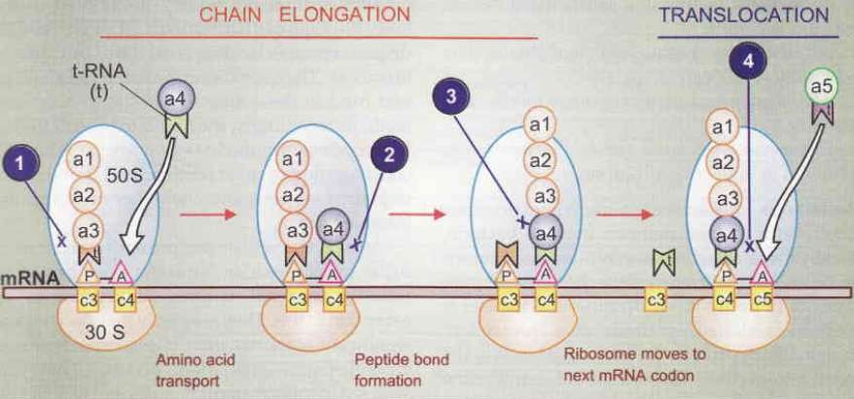

Slide 10
Transport of drug:
Diffuse across the outer coat of bacteria through porin channel
Penetration is oxygen dependent active process
Inactivated under anaerobic condition
Also favoured by high pH

Slide 11
Cidal action due to secondary change in cell membrane • Energy dependent phase II process
After exposure sensitive bacteria become more permeable
Ions, amino acid and protein leak out
Cell death
Cidal effect is concentration dependent
Rate of bacterial cell killing directly related to ratio of peak antibiotic concentration to MIC
Also exert post antibiotic effect

Slide 12
Pharmacokinetics:
Highly polar cations
very poorly absorbed from the GI tract
Absorption of gentamicin from the GI tract may be increased by GI disease (e.g., ulcers or inflammatory bowel disease)
All the aminoglycosides are absorbed rapidly from intramuscular sites of injection
Because of their polar nature, the aminoglycosides do not penetrate into most cells, the CNS, or the eye
Plasma protein binding: neglible
Vd:25% of lean body weight –equal to ECF
Concentrations of aminoglycosides in secretions and tissues are low

Slide 13
Excreted almost entirely by glomerular filtration
Large fraction of a parenterally administered
dose is excreted unchanged during first 24 hour
t1/2: 2-4 hrs
Aminoglycosides can be inactivated by various
penicillins in vitro and thus should not be
admixed in solution

Slide 14
Unwanted effects
Ototoxicity
-Ototoxicity results in irreversible, bilateral high frequency hearing loss and temporary vestibular hypofunction
-Degeneration of hair cells and neurons in the cochlea correlates with the loss of hearing
-Ototoxicity higher when plasma concentration of drug is persistently high
Cochlear toxicity
-Start from base to apex
Symptoms:
• Tinnitus –high pitched
• Progressive hearing loss
• Duration: On stopping of drug, tinnitus disappears but frequency loss persist

